Slide 1
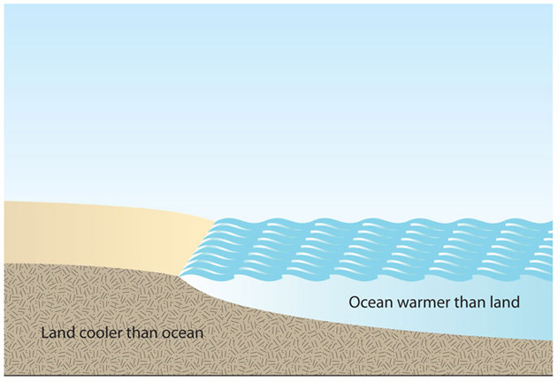
Onshore and offshore breezes
Overnight the land usually cools faster than the sea. In the morning, the sea’s surface temperature is usually higher than the temperature of the land.

Slide 2
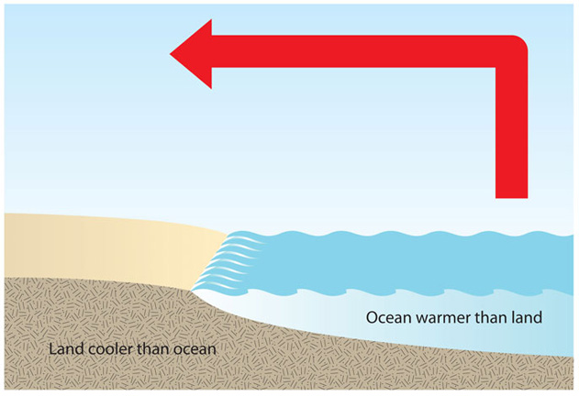
The warmed air above the sea rises

Slide 3
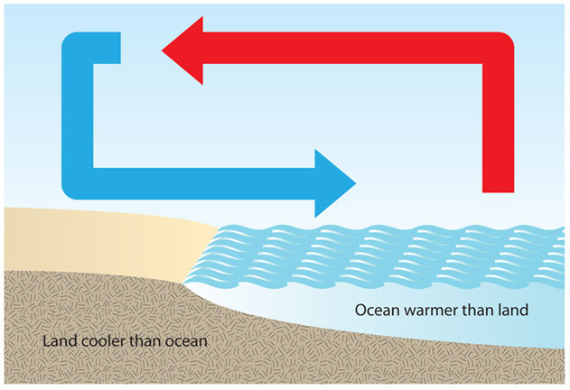
The cooler air over the land sinks — and moves towards the sea to fill the place of the warmer, rising air. This creates an offshore breeze.

Slide 4
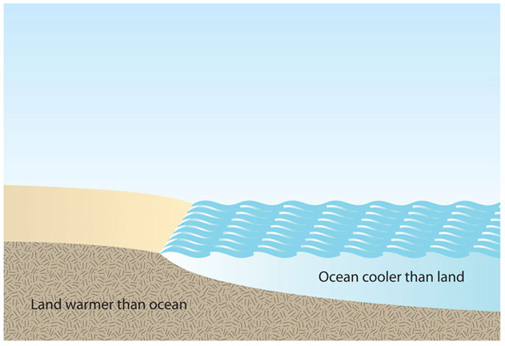
Afternoon
The sea takes longer than the land to heat up. Usually by the end of the day, the temperature of the land has increased to become higher than that of the sea’s surface temperature.

Slide 5
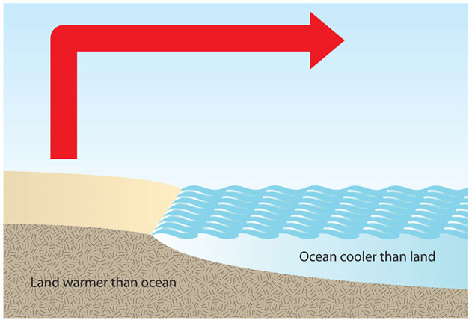
The air above the land is heated, causing it to rise.

Slide 6
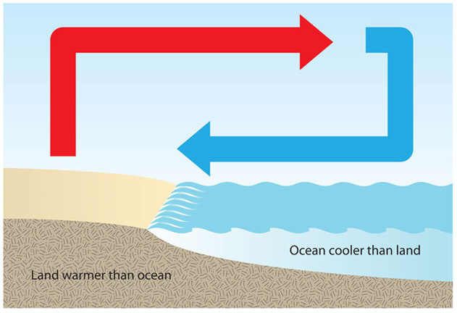
The cooler air over the sea sinks and moves towards the land to fill the space left by the rising, warmer air. This causes an onshore breeze.

